Slide 1
DS 4300
AWS Introduction
Mark Fontenot, PhD
Northeastern University

Slide 2
Amazon Web Services
Leading Cloud Platform with over 200 different services available
Globally available via its massive networks of regions and availability zones with their massive data centers
Based on a pay-as-you-use cost model.
Theoretically cheaper than renting rackspace/servers in a data center… Theoretically.

Slide 3
History of AWS
Originally launched in 2006 with only 2 services: S3 & EC2.
By 2010, services had expanded to include SimpleDB, Elastic Block Store, Relational Database Service, DynamoDB, CloudWatch, Simple Workflow, CloudFront, Availability Zones, and others.
Amazon had competitions with big prizes to spur the adoption of AWS in its early days
They’ve continuously innovated, always introducing new services for ops, dev, analytics, etc… (200+ services now)

Slide 4
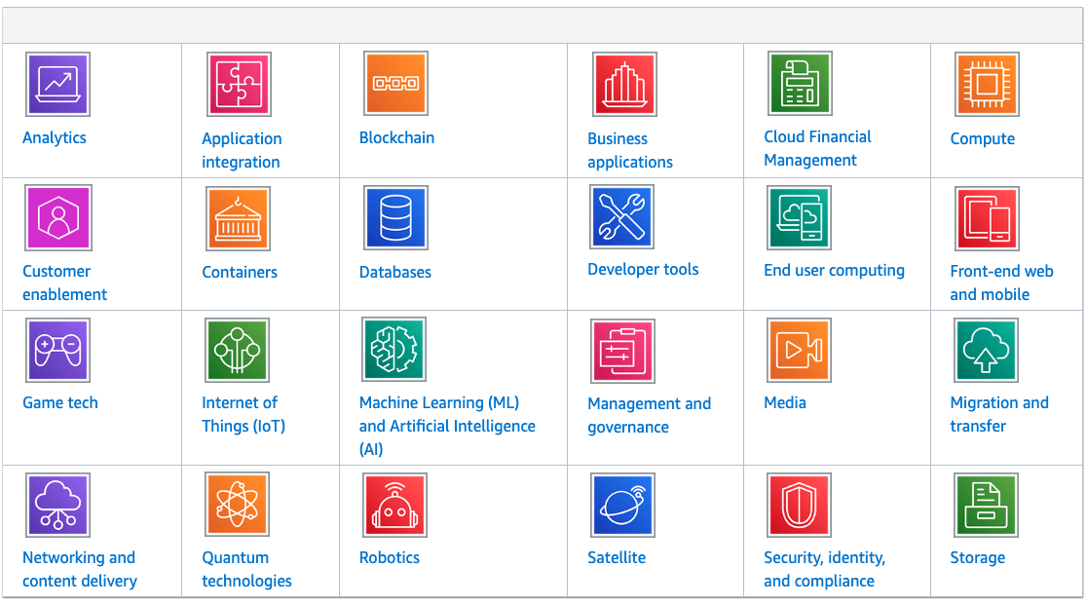
AWS Service Categories

Slide 5
Cloud Models
IaaS (more) - Infrastructure as a Service
Contains the basic services that are needed to build an IT infrastructure
PaaS (more) - Platform as a Service
Remove the need for having to manage infrastructure
You can get right to deploying your app
SaaS (more) - Software as a Service
Provide full software apps that are run and managed by another party/vendor

Slide 6
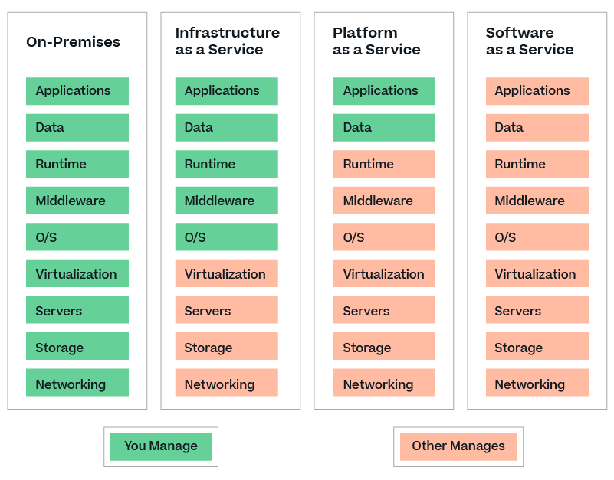
Cloud Models
https://bluexp.netapp.com/iaas

Slide 7
The Shared Responsibility Model - AWS
AWS Responsibilities (Security OF the cloud):
Security of physical infrastructure (infra) and network
keep the data centers secure, control access to them
maintain power availability, HVAC, etc.
monitor and maintain physical networking equipment and global infra/connectivity
Hypervisor & Host OSs
manage the virtualization layer used in AWS compute services
maintaining underlying host OSs for other services
Maintaining managed services
keep infra up to date and functional
maintain server software (patching, etc)

Slide 8
The Shared Responsibility Model - Client
Client Responsibilities (Security IN the cloud):
Control of Data/Content
client controls how its data is classified, encrypted, and shared
implement and enforce appropriate data-handling policies
Access Management & IAM
properly configure IAM users, roles, and policies.
enforce the Principle of Least Privilege
Manage self-hosted Apps and associated OSs
Ensure network security to its VPC
Handle compliance and governance policies and procedures

Slide 9
The AWS Global Infrastructure
Regions - distinct geographical areas
us-east-1, us-west 1, etc
Availability Zones (AZs)
each region has multiple AZs
roughly equiv to isolated data centers
Edge Locations
locations for CDN and other types of caching services
allows content to be closer to end user.

Slide 10
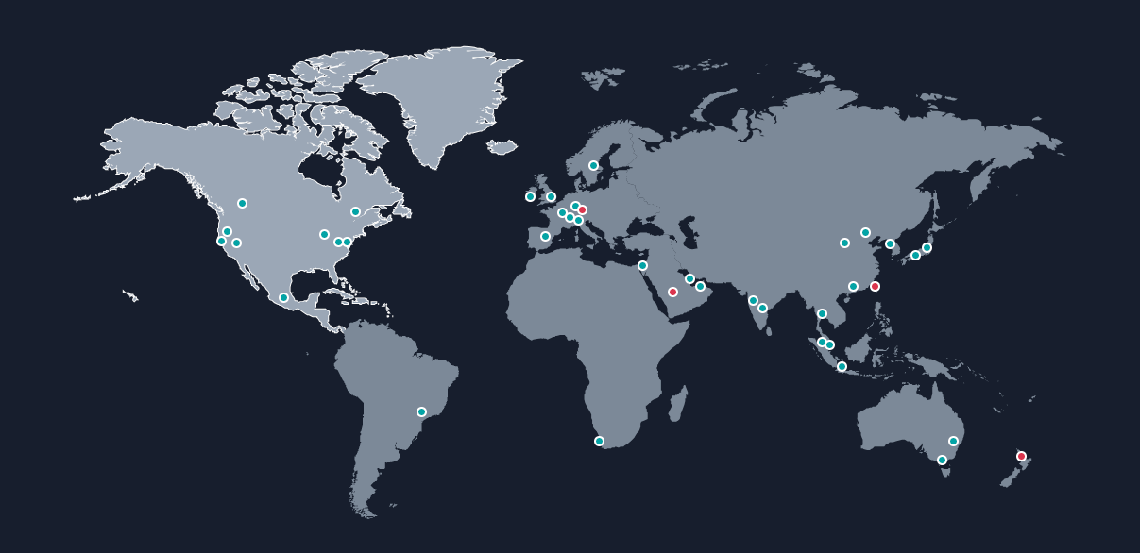

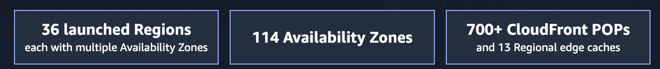
https://aws.amazon.com/about-aws/global-infrastructure/

Slide 11






Compute Services
VM-based:
EC2 & EC2 Spot - Elastic Cloud Compute
Container-based:
ECS - Elastic Container Service
ECR - Elastic Container Registry
EKS - Elastic Kubernetes Service
Fargate - Serverless container service
Serverless: AWS Lambda
https://aws.amazon.com/products/compute/

Slide 12



Storage Services
Amazon S3 - Simple Storage Service
Object storage in buckets; highly scalable; different storage classes
Amazon EFS - Elastic File System
Simple, serverless, elastic, “set-and-forget” file system
Amazon EBS - Elastic Block Storage
High-Performance block storage service
Amazon File Cache
High-speed cache for datasets stored anywhere
AWS Backup
Fully managed, policy-based service to automate data protection and compliance of apps on AWS
https://aws.amazon.com/products/storage/

Slide 13







Database Services
Relational - Amazon RDS, Amazon Aurora
Key-Value - Amazon DynamoDB
In-Memory - Amazon MemoryDB, Amazon ElastiCache
Document - Amazon DocumentDB (Compat with MongoDB)
Graph - Amazon Neptune

Slide 14






Analytics Services
Amazon Athena - Analyze petabyte scale data where it lives (S3, for example)
Amazon EMR - Elastic MapReduce - Access Apache Spark, Hive, Presto, etc.
AWS Glue - Discover, prepare, and integrate all your data
Amazon Redshift - Data warehousing service
Amazon Kinesis - real-time data streaming
Amazon QuickSight - cloud-native BI/reporting tool

Slide 15





ML and AI Services
Amazon SageMaker
fully-managed ML platform, including Jupyter NBs
build, train, deploy ML models
AWS AI Services w/ Pre-trained Models
Amazon Comprehend - NLP
Amazon Rekognition - Image/Video analysis
Amazon Textract - Text extraction
Amazon Translate - Machine translation

Slide 16
Important Services for Data Analytics/Engineering
EC2 and Lambda
Amazon S3
Amazon RDS and DynamoDB
AWS Glue
Amazon Athena
Amazon EMR
Amazon Redshift

Slide 17
AWS Free Tier
Allows you to gain hands-on experience with a subset of the services for 12 months (service limitations apply as well)
Amazon EC2 - 750 hours/month (specific OSs and Instance Sizes)
Amazon S3 - 5GB (20K GETs, 2K Puts)
Amazon RDS - 750 hours/month of DB use (within certain limits)
….. So many free services

Slide 18
??

